Slide 1


Generative AI
Transfer learning

Slide 2
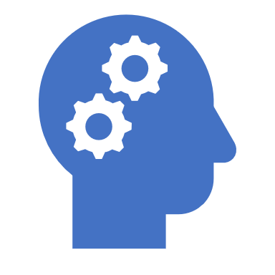
Transfer learning

Slide 3
Transfer learning
Transfer learning is a machine learning technique where a model developed for a particular task is reused as the starting point for a model on a second task.
This approach is particularly useful when the second task has limited data available, as it allows the model to leverage the knowledge gained from the first task, which typically has a larger dataset.

Slide 4
Transfer learning
Transfer learning involves taking a pre-trained model (usually trained on a large dataset) and fine-tuning it on a smaller, task-specific dataset.
This can significantly reduce the time and resources needed to train a model from scratch and can lead to better performance, especially in scenarios where data is scarce.
Transfer learning is commonly used in various applications, such as natural language processing (NLP) and computer vision, where models like BERT or ResNet are pre-trained on large datasets and then adapted for specific tasks like sentiment analysis or image classification.

Slide 5
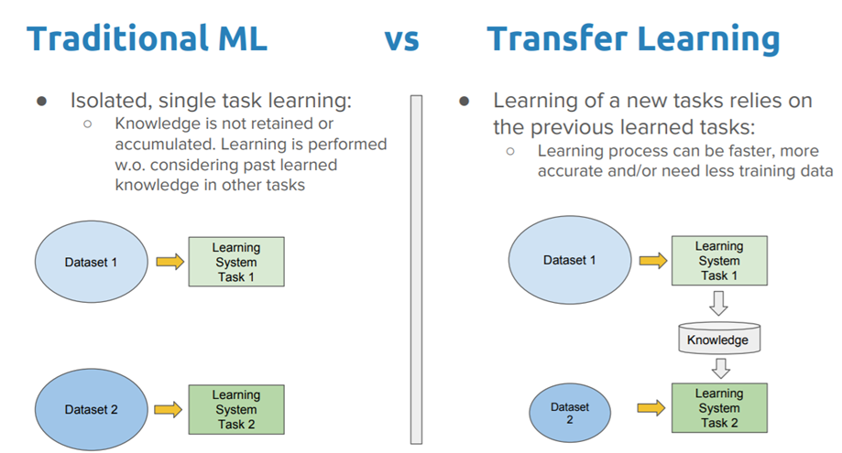
Traditional ML vs transfer learning

Slide 6
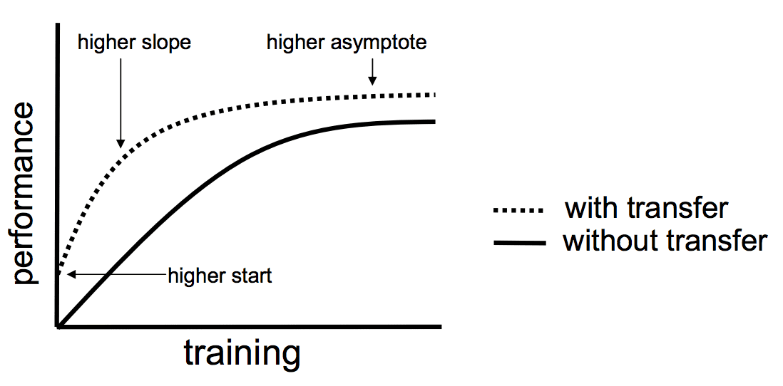
Why transfer learning?

Slide 7
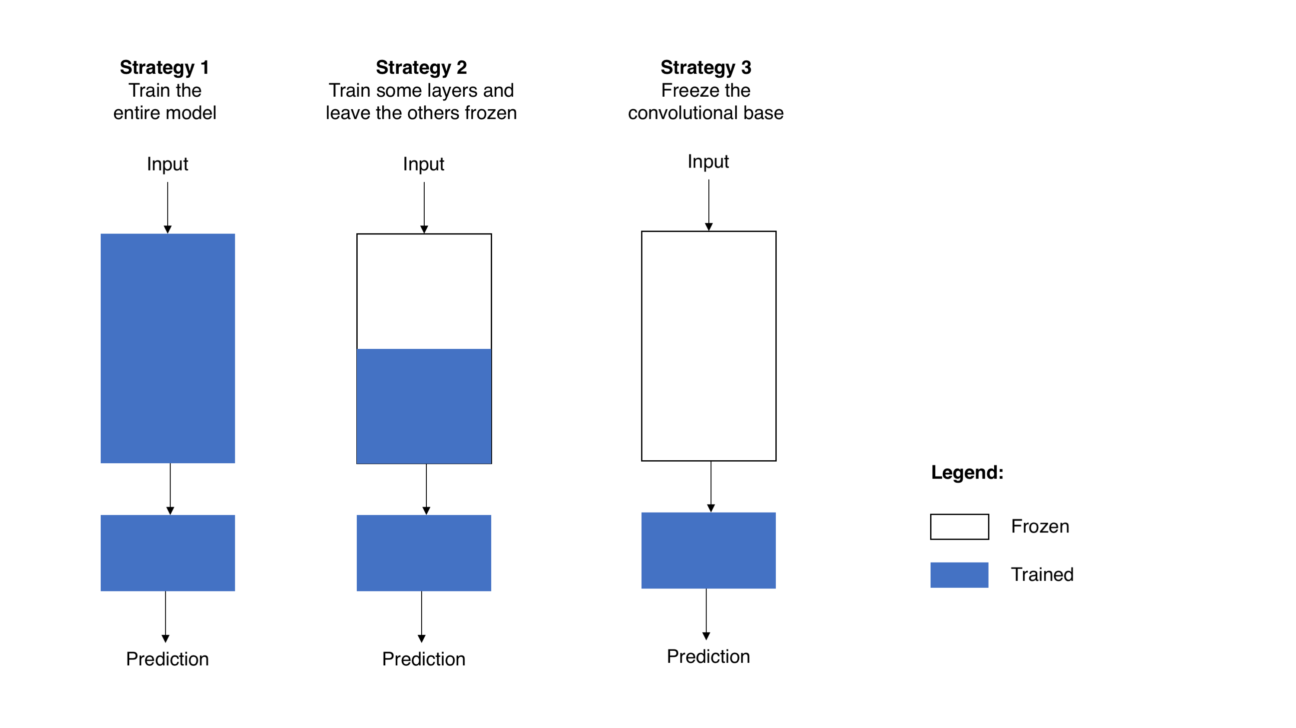
Transfer Learning Strategies in computer vision

Slide 8
Three different strategies for training CNNs
Strategy 1: Train the Entire Model
In this approach, all layers of the model are updated (shown in blue).
Useful when you have a large dataset similar to the original training data of the pre-trained model.
Allows the model to learn new features specific to the target data but requires more computational resources.
Strategy 2: Train Some Layers and Freeze Others
Only the final layers are trained (blue), while the earlier layers remain frozen (white).
Effective if the dataset is small or somewhat different from the original dataset.
Reduces computation by not updating all layers, allowing the model to retain lower-level features while adapting higher-level ones.
Strategy 3: Freeze the Convolutional Base
The entire base of the model is frozen, with only the final layer (output layer) trained.
Best when you have a very small dataset or need to transfer the features without altering the main learned representations.
Significantly reduces computation and prevents overfitting, as only the classifier head is trained.

Slide 9

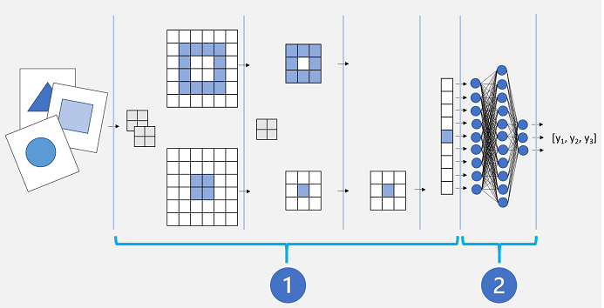
Transfer Learning in CV

Slide 10
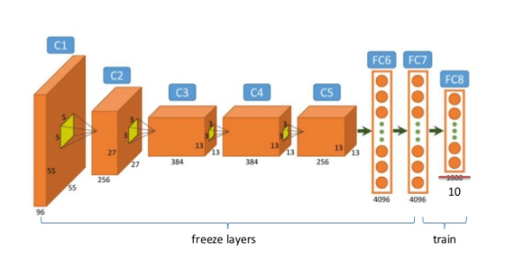
Frozen and trainable layers in CNN

Slide 11
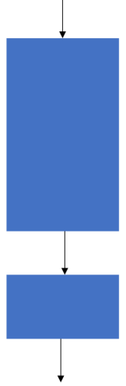
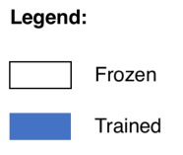
Transfer Learning in NLP
Transfer learning strategies for NLP involve similar principles as in computer vision but are tailored to the unique architecture of NLP models, especially large language models.
Fine-Tuning the Entire Model
Description: This approach involves training all layers of a pre-trained NLP model on your specific target dataset.
Use Case: Useful when you have a large labeled dataset that's domain-specific, such as legal or medical texts.
Advantages: Model adapts fully to the nuances of the target data.
Drawbacks:
Computationally expensive, especially with large models like BERT or GPT-based architectures.
Higher risk of overfitting if the dataset is small.

Slide 12
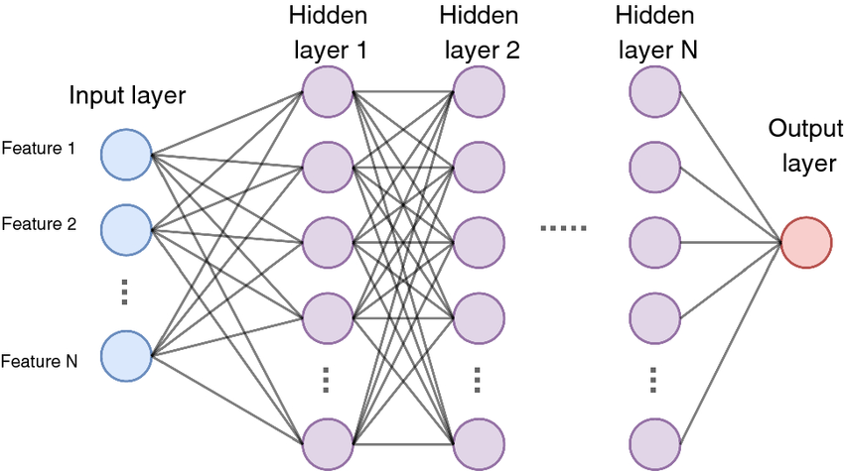
DNN
higher layers / topping
lower layers

Slide 13
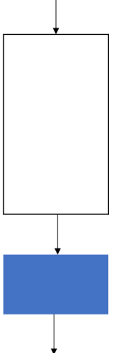
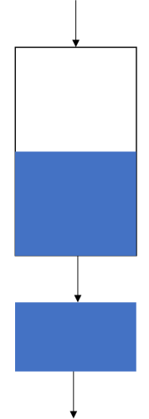
Transfer Learning in NLP
Fine-Tuning Only Higher Layers
Description: Here, the lower layers (closer to input) remain frozen, while only the higher layers are fine-tuned.
Use Case: Ideal when the target dataset is small and there are specific patterns or terms in the target domain that are different from general language use (e.g., technical or industry-specific vocabulary).
Advantages:
Retains core language understanding in lower layers while allowing model customization for the domain in upper layers.
Less computationally intensive than full model fine-tuning.
Drawbacks: Limited adaptability, as lower-level language features (like morphology or syntax) remain unchanged.
OR

Slide 14
Transfer Learning in NLP
Prompt Tuning
Description: Instead of fine-tuning the model parameters, the model is prompted with task-specific text patterns. This involves learning a set of soft prompts or embeddings that guide the model's behavior for a specific task.
Use Case: Best suited for very large models (like GPT-3 and GPT-4) where direct parameter tuning is impractical, or when working with few-shot or zero-shot learning scenarios.
Advantages:
Efficient for large-scale language models.
Avoids altering model parameters, maintaining generalizability across tasks.
Drawbacks: Relies heavily on prompt engineering, which can be challenging to optimize.

Slide 15
Transfer Learning in NLP
Embedding Layer Fine-Tuning
Description: Only the embedding layer (first layer that maps input words to dense vectors) is trained, while other layers are frozen.
Use Case: Suitable for tasks where the vocabulary or semantic meanings are different from those in the pre-trained model (e.g., medical jargon, slang, or industry-specific terms).
Advantages: Efficient and lightweight, focusing solely on improving vocabulary understanding.
Drawbacks: Limited effect on overall model behavior, as deeper model semantics remain unchanged.

Slide 16
Transfer Learning in NLP
Distillation-Based Fine-Tuning
Description: Involves training a smaller "student" model to mimic a larger "teacher" model's behavior on a specific task, usually by using the teacher's predictions as soft labels.
Use Case: Useful when you need a smaller, faster model for deployment without losing too much performance.
Advantages:
Greatly reduces model size and inference time.
Maintains most of the teacher model’s performance.
Drawbacks: Requires an additional training step and can be difficult to match the teacher’s accuracy on complex tasks.

Slide 17
Fine Tuning Summary
Strategy | Description | Use Case | Pros | Cons | References
Full Fine-Tuning | Train all layers on new data | Large domain-specific dataset | Best for deep adaptation | Expensive; risk of overfitting | Howard & Ruder (2018)
Higher Layers Fine-Tuning | Freeze lower layers, fine-tune upper | Small, specialized dataset | Balances adaptation and efficiency | Limited flexibility | Peters et al. (2019)
Prompt Tuning | Task-specific prompts without changes | Few-shot, large models (T5, GPT-3/4) | No parameter change; efficient | Requires prompt engineering | Liu et al. (2021)
Embedding Fine-Tuning | Fine-tune only embedding layer | Domain-specific vocabulary | Lightweight, improves vocab fit | Minimal overall effect | Turc et al. (2019)
Distillation | Train small model to mimic larger model | Smaller, faster deployment models | Fast, compact model | Complex setup, possible accuracy loss | Sanh et al. (2019)

Slide 18
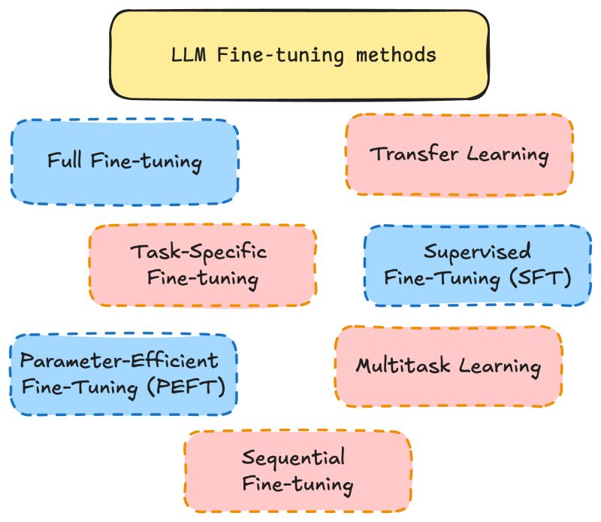
Fine-tunning Summary

Slide 19
Choosing the Right Strategy
Choosing the best strategy depends on:
Data Size: Full fine-tuning requires large datasets; smaller datasets work better with partial or adapter-based methods.
Computational Constraints: Adapters and prompt tuning are less resource-intensive.
Domain Specificity: If the target domain is highly specialized, strategies that allow some adaptation of word embeddings or higher layers (like fine-tuning the last few layers) may work best.

Slide 20
Small LLMs (Distilled Models)
Definition: Language Models with fewer parameters compared to large-scale models like
Small LLMs provide a balance between performance and efficiency, making them suitable for a wide range of applications where resources are constrained.
Key Characteristics
Size: Typically less than a few hundred million parameters compared to billions for LLMs.
Efficiency: Lower computational and memory requirements.
Speed: Faster inference times compared to larger models.
Accessibility: Easier to deploy on devices with limited resources (e.g., mobile phones, edge devices).

Slide 21
Distillation
Distillation in NLP, often called Knowledge Distillation, is a technique where a smaller, simpler model (called the student) is trained to replicate the behavior of a larger, more complex model (the teacher).
The idea is to retain most of the teacher model’s knowledge and accuracy but in a compact, efficient model that requires less computation and memory, making it faster and easier to deploy.

Slide 22
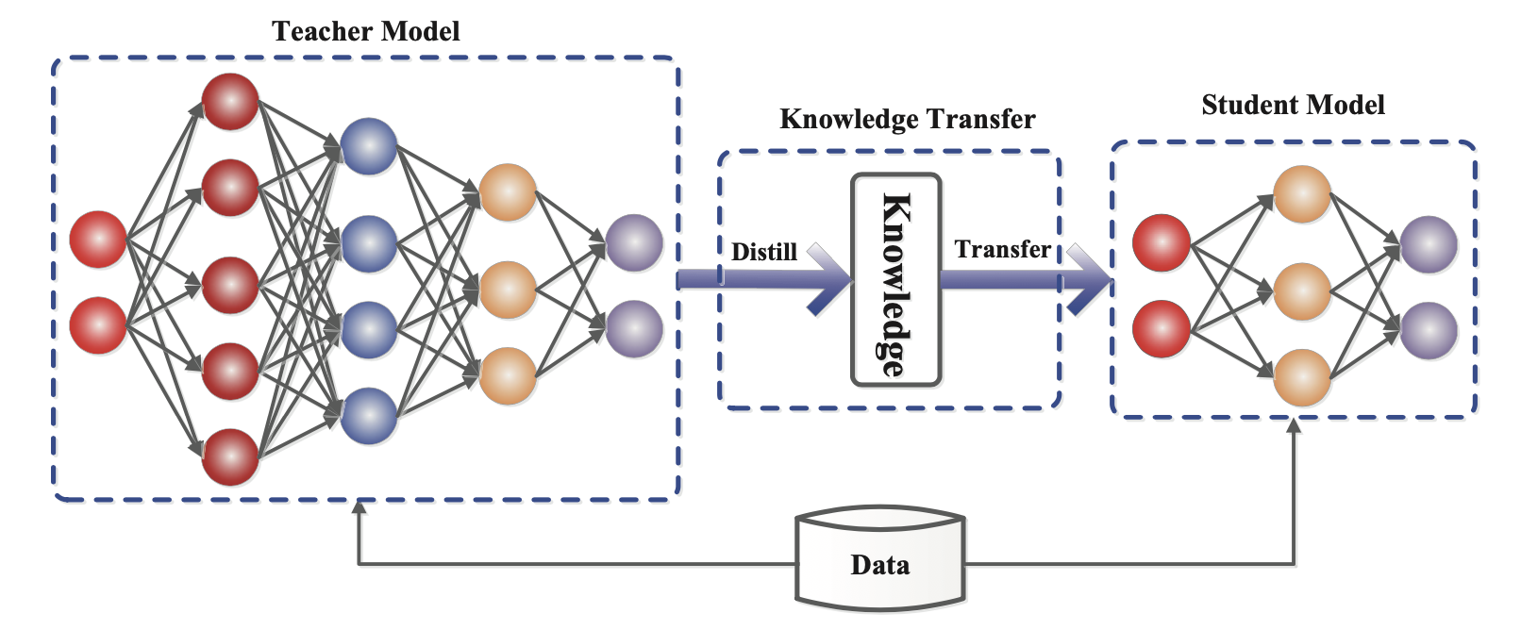
The generic framework of teacher-student knowledge distillation training. (Image source: Gou et al. 2020)

Slide 23
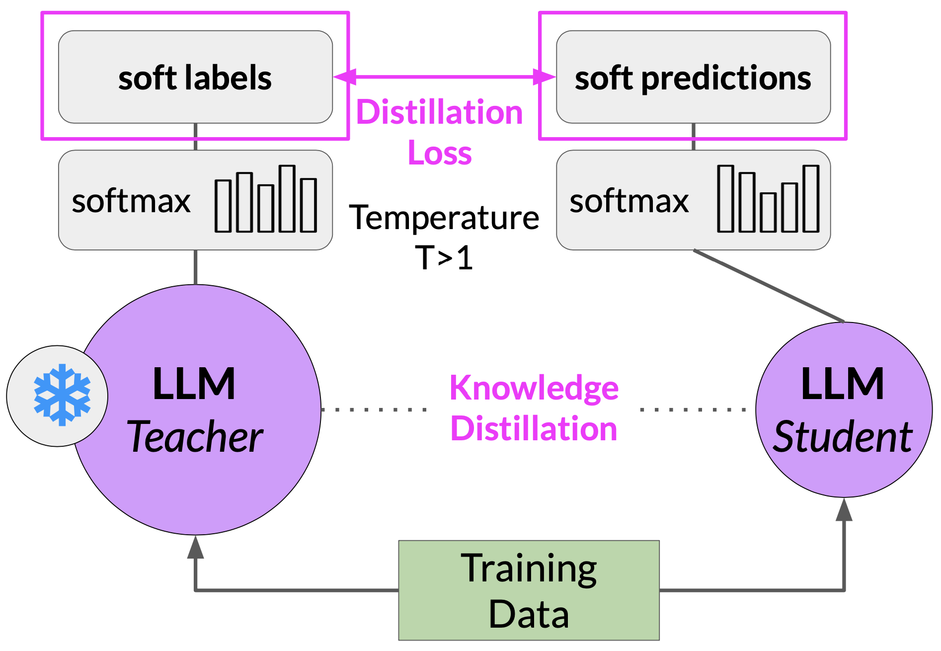
Distillation uses a larger model, the teacher model to train a smaller model, the student model. The smaller model is then used for inference to lower your storage and compute cost.

Slide 24
soft and hard labels
The teacher model is already fine-tuned on the training data. So, the probability distribution likely closely matches the ground truth data and won’t have much variations in tokens.
SO, when temperature > 1 then, probability distribution becomes broader.
T > 1 => Teacher’s output –> soft labels and Student’s output –> soft predictions
T = 1 => Teacher’s output –> hard labels and Student’s output –> hard predictions

Slide 25
soft and hard labels
Hard labels: One-hot encoded, clear-cut classification.
Soft labels: Probability distributions that provide more information.
Why Use Soft Labels in Distillation?
Better Generalization: Soft labels provide richer information than hard labels, helping the student model learn inter-class similarities.
Handling Noisy Data: The probability distribution smooths out noise in hard labels.
Compression of Knowledge: The student model absorbs knowledge from the teacher beyond just the final class decision.

Slide 26
Key Steps in Distillation
Train the Teacher Model: First, a large model (like BERT or GPT) is pre-trained and fine-tuned on a specific task or dataset. This teacher model has high accuracy but is resource-intensive.
Generate Soft Labels: The teacher model is used to produce soft labels (or probabilities) for the training data, providing nuanced guidance beyond traditional hard labels.
Train the Student Model: The student model is then trained using these soft labels from the teacher, encouraging it to match the teacher's predictions. This allows the student to learn patterns and representations similar to those learned by the teacher, without needing as many parameters.

Slide 27
Types of Distillation in NLP
Logit Distillation: Only the teacher model's output probabilities (logits) are used to train the student model. The student is encouraged to mimic the output distribution of the teacher.
Feature Distillation: Intermediate layer features (activations) from the teacher are also used as guidance, allowing the student to match representations at multiple levels, not just the final output.
Self-Distillation: The same model is used as both teacher and student, where a larger or pre-trained version of the model is fine-tuned on the task and then distilled to a smaller architecture of itself.

Slide 28
Advantages of Distillation
Efficiency: Distilled models are much smaller, making them faster for inference and ideal for deployment on devices with limited resources.
Maintain Accuracy: Despite the size reduction, distilled models often retain much of the teacher’s accuracy, making them effective alternatives in production environments.
Less Data Needed: Distilling on soft labels provided by the teacher can enable the student model to generalize better even with less data.

Slide 29
Applications in NLP
Text Classification: Using a smaller model for real-time classification tasks while retaining the performance of a larger BERT-based model.
Question Answering: Deploying a distilled model for quick and accurate responses in chatbot systems.
Machine Translation: Reducing the computational burden in translation systems while preserving translation quality.

Slide 30
Example of a Successful Distillation: DistilBERT
DistilBERT is a popular distilled version of BERT that retains 97% of BERT’s language understanding while being 60% faster and using 40% fewer parameters.
DistilBERT is trained using logit distillation and feature matching, effectively reducing BERT’s size and computational requirements without major accuracy loss.

Slide 31
Quantization
Post training, quantization transforms a model’s weight to a lower precision representation like 16 bit float, or 8 it integer.
Memory usage can be reduced by reducing precision from 32 bit floating point number to 16 bit floating number or 8 bit integers. Following datatypes can be used to train a quantized models:
FP32 –> 32 bit floating point
FP16 –> 16 bit floating point
BFLOAT16 –> 16 bit floating point half precision
INT8 –> 8 bit integers
BFLOAT16 is truncated FP32. BFLOAT16 is used to pretrain most of the LLMs including FLAN T5.
Given is below is the ram requirements to store 1B parameter model:
Full Precision Model –> 4GB@32 bit full precission
16-bit quantized Model –> 2GB@16 bit half precission
8-bit quantized Model –> 1GB@8 bit precission

Slide 32
Pruning
Model Pruning removes redundant model parameters that contribute little to the model’s preformance. It removes model weights with values close or equal to zero.

Slide 33
Distilled Model Limitations
Possible Loss of Accuracy: While distillation aims to retain performance, smaller models might still lose some of the teacher's nuanced understanding, especially on complex tasks.
Teacher Dependence: The quality of the student model heavily depends on the teacher model’s quality. If the teacher has biases or errors, these may be passed on to the student.

Slide 34
Some references
Sanh, V. (2019). DistilBERT, A Distilled Version of BERT: Smaller, Faster, Cheaper and Lighter. arXiv preprint arXiv:1910.01108. Sanh et al. (2019)
Jiao et al. (2019) - TinyBERT: Distilling BERT for Natural Language Understanding: Further innovations in the distillation process, optimizing BERT for even smaller tasks and improving efficiency.
https://arxiv.org/abs/1909.10351

Slide 35
Differences between Large Language Models (LLMs) and Small Language Models (SLMs)
Aspect | Large Language Models (LLMs) | Small Language Models (SLMs)
Model Size | Billions of parameters | Millions of parameters
Training Data | Massive datasets (internet-scale) | Smaller, specific datasets
Resource Requirements | High computational power (GPUs/TPUs, large memory) | Low resource usage (runs on CPU, lower memory)
Performance | High performance on complex tasks | Optimized for specific, simpler tasks
Inference Speed | Slower, higher latency | Fast, low latency
Deployment | Typically in cloud or centralized environments | Suitable for edge devices and on-device processing
Adaptability | General-purpose, adaptable to many domains | Task-specific and optimized for narrow use cases
Cost of Deployment | Expensive (due to server and GPU requirements) | Cost-effective for scaled edge deployments

Slide 36
Role of SLMs in Edge Computing
Small Language Models (SLMs) are specifically beneficial for edge computing because of their lightweight, efficient nature, and ability to run on devices with limited processing power and memory, like mobile devices, IoT devices, or embedded systems.

Slide 37
how SLM contribute to edge computing
Reduced Latency: Processes data locally, enabling fast, real-time responses.
Enhanced Privacy: Keeps data on-device, improving privacy and security.
Energy Efficiency: Uses minimal power, ideal for battery-operated devices.
Cost-Effective Scalability: Reduces cloud dependency, enabling large-scale, affordable deployments.
Offline Functionality: Operates without internet, suitable for remote or network-limited areas.
Real-Time Decision-Making: Supports quick, localized analytics and actions, valuable for industrial IoT and other time-sensitive applications.

Slide 38
Use Cases of SLMs in Edge Computing
Voice Assistants: Running speech recognition or natural language understanding locally for quick and private responses.
Predictive Text and Keyboard Apps: Fast and responsive predictive text suggestions on mobile devices.
Industrial IoT: Real-time data processing for predictive maintenance or anomaly detection, reducing downtime and improving operational efficiency.
Healthcare Devices: Processing patient data locally on wearable devices to provide immediate feedback without sending sensitive information to the cloud.

Slide 39
Industrial IoT (IIoT) and Small Language Models (SLMs)
Small Language Models (SLMs) are deployed on edge devices to enable real-time processing and analysis of language data generated within industrial environments.

Slide 40
Use cases where SLMs enhance IIoT applications
Predictive Maintenance
Role of SLMs: SLMs can analyze equipment logs, sensor readings, and technician notes directly on the edge, identifying patterns and predicting failures before they happen.
Benefit: By processing data locally, SLMs enable real-time alerts and rapid decision-making, reducing unplanned downtime and maintenance costs.
Anomaly Detection in Production
Role of SLMs: SLMs process structured and unstructured data from sensors or machine logs, detecting unusual patterns that could indicate malfunctions or inefficiencies.
Benefit: Early detection of issues helps avoid production halts, improve quality control, and maintain consistent product quality by taking immediate corrective actions.

Slide 41
Use cases where SLMs enhance IIoT applications
Natural Language Interfaces for Technicians
Role of SLMs: SLMs power on-device voice assistants or text-based interfaces, allowing technicians to query equipment or receive diagnostic information using natural language.
Benefit: Voice or text interaction simplifies troubleshooting and operation, making complex industrial processes more accessible and reducing training time for operators.
Automated Reporting and Documentation
Role of SLMs: SLMs automatically generate and update reports based on real-time data from sensors and human input, summarizing maintenance actions, production stats, and system health.
Benefit: This saves time and reduces errors, enabling managers and engineers to quickly review operational data without needing a centralized reporting infrastructure.

Slide 42
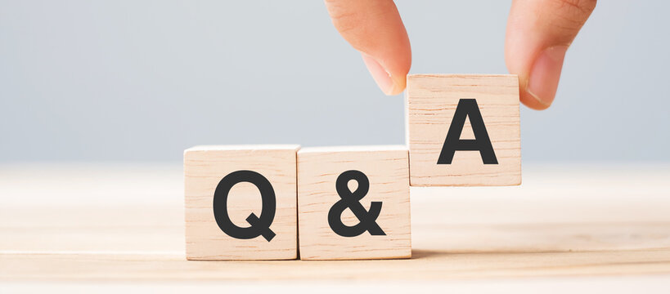
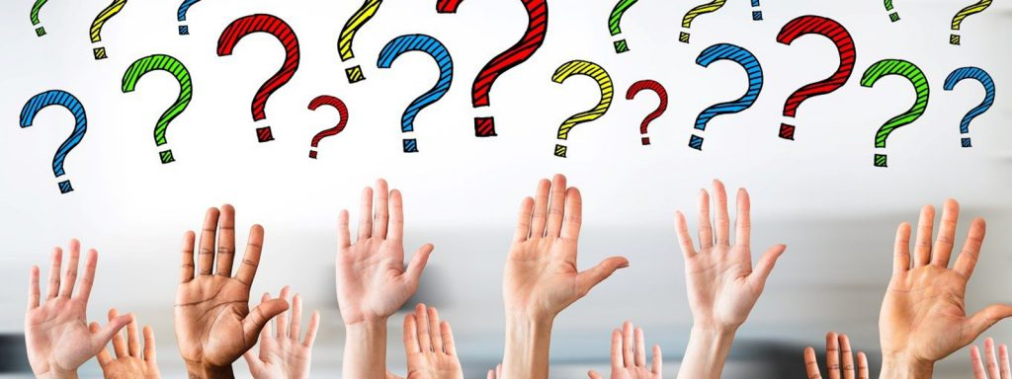
Q&A

